Slide 1
Science 8-Chapter 4—Lesson 2
Light

Slide 2
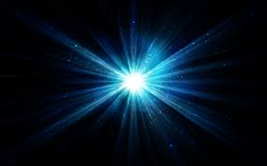
light
type of wave called an electromagnetic wave

Slide 3
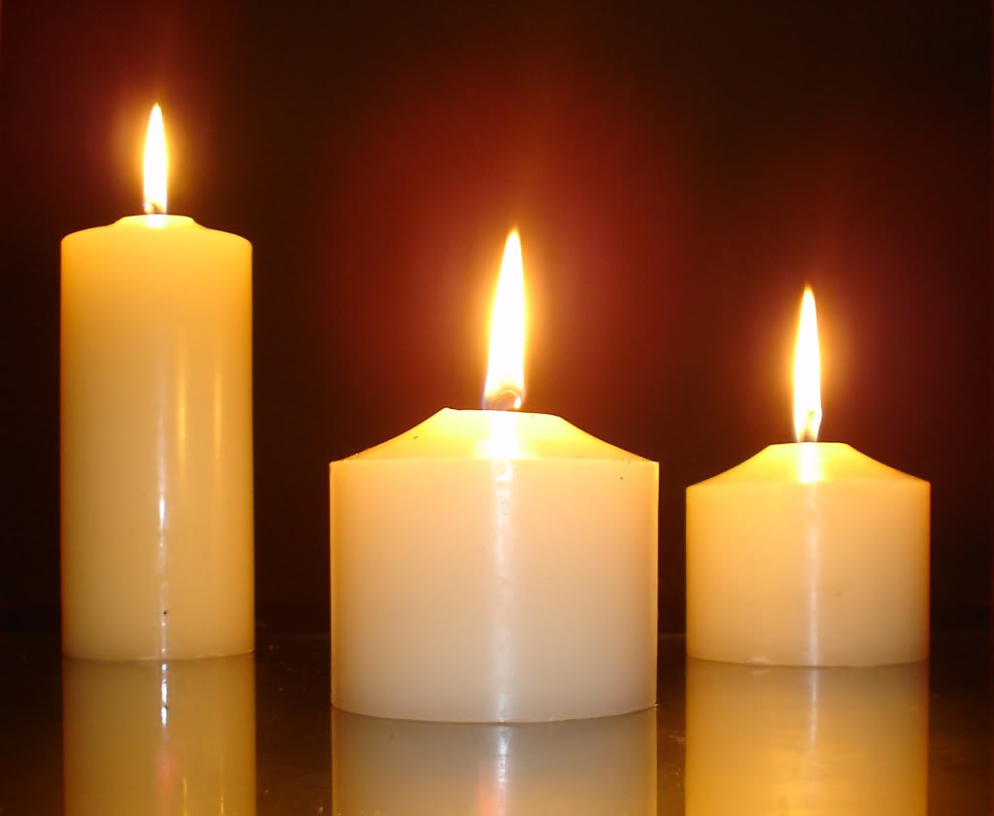
light source
something that emits light

Slide 4
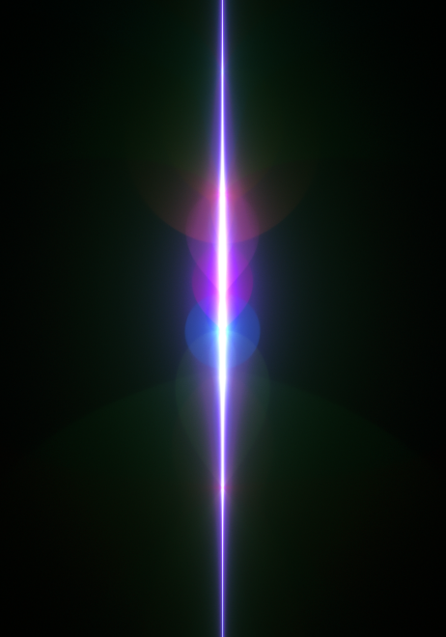
light ray
a narrow beam of light that travels in a straight line

Slide 5
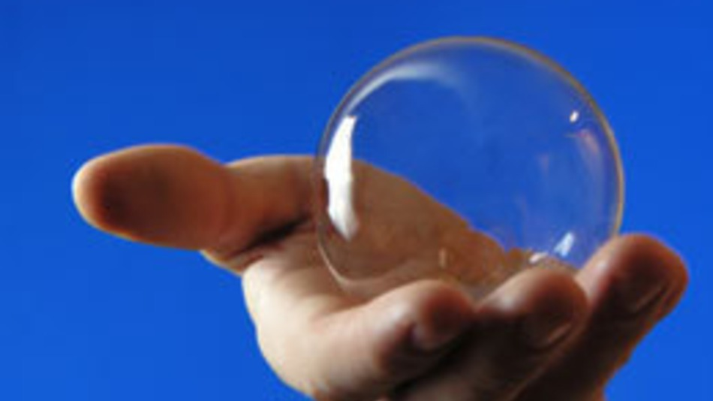
transparent
a material that allows almost all light that strikes it to pass through and forms a clear image

Slide 6
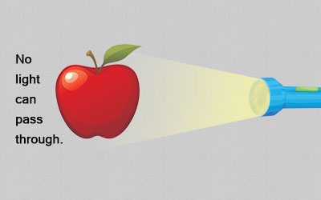
opaque
a material that light does not pass through

Slide 7
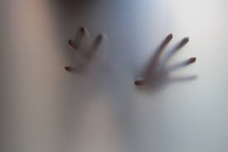
translucent
a material that allows most of the light that strikes it to pass through but forms a blurry image

Slide 8
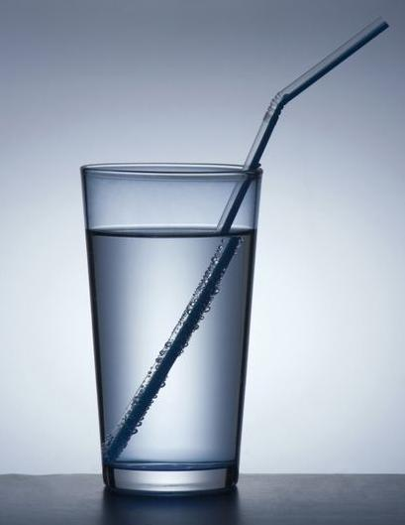
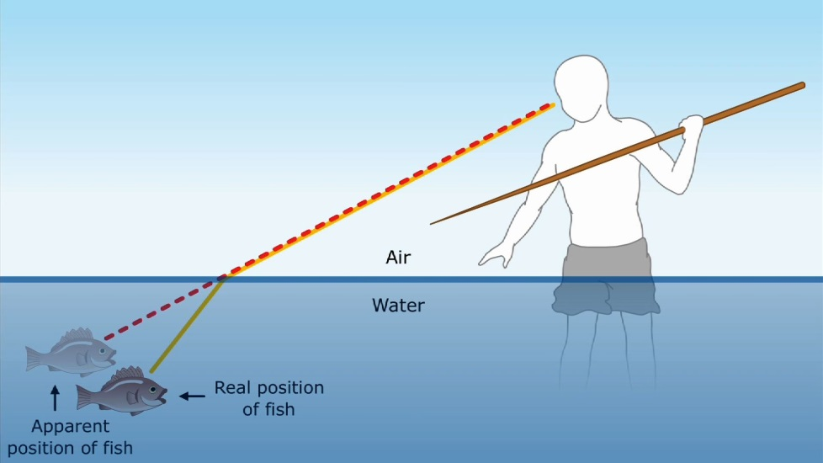
refraction
a wave that changes direction as it travels from one material into another

Slide 9
reflection
light waves come in contact with the surface of a material and bounce off

Slide 10
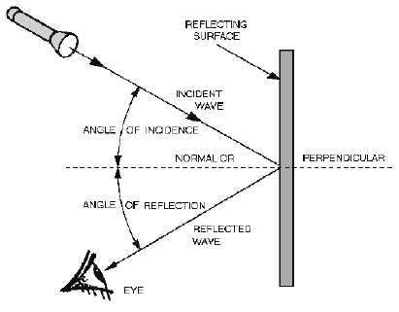
law of reflection
the angle of incidence equals the angle of reflection for a wave

Slide 11
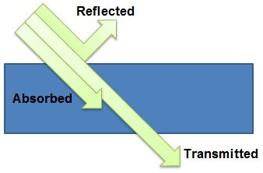
absorption
energy from light wave is transferred to matter

Slide 12
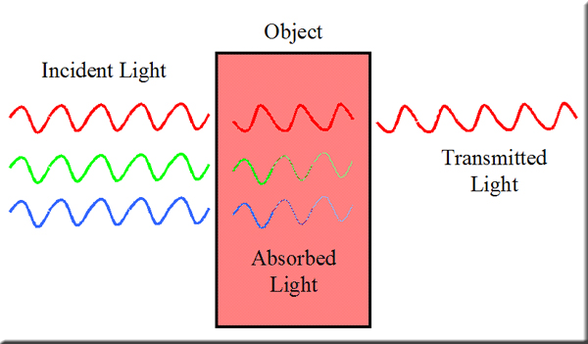
transmission
light wave travels through a material

Slide 13
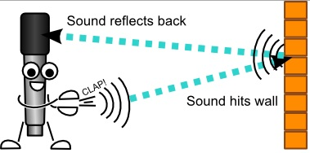
echo
a reflected sound wave
Echo

Slide 14
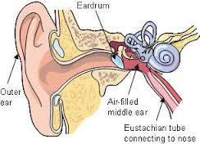
eardrum
a thin membrane that stretches across the ear canal

Slide 15
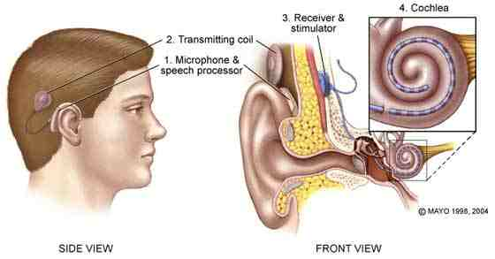
cochlea
a structure in the inner ear

Slide 16
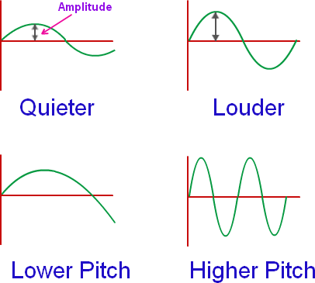
loudness
the human sensation of how much energy a sound wave carries
Loudness

Slide 17
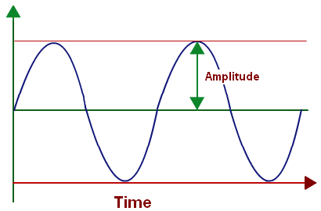
amplitude
a measure of the energy in a sound wave

Slide 18
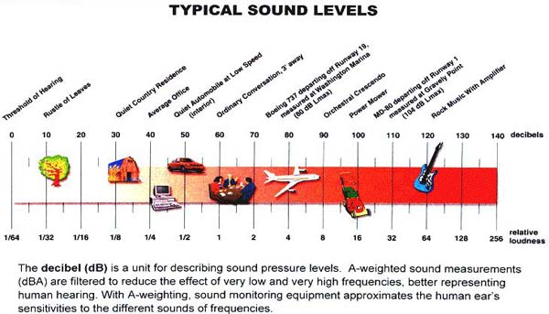
decibel
the measuring unit of the loudness of sounds

Slide 19
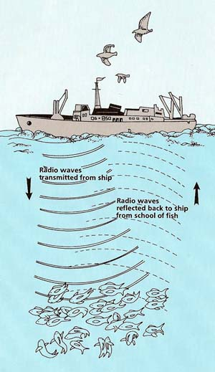
sonar
a system that uses sound waves to locate underwater objects

